Slide 1



Demographic Analysis for Grocery Sales
Submitted by:
Abhinav Chadha
Puneet Maini
Rebecca Bland
Rizabek
Sanjeet Walia
Sumeet Duddagi
z

Slide 2

Introduction
A multinational retail company that has operations in 5 countries carried out several marketing campaigns among over 2000 existing customers. The campaigns were deemed to be underperformed and the acceptance rate was around 7%.
A company has a dataset that contains information about customers' profiles, preferences, purchase history, and responses to the marketing campaigns. A company wants to derive insight from this dataset and receive concrete recommendations on how to improve the future marketing campaign.
The dataset doesn’t provide details about the marketing campaigns themselves therefore the focus was on analyzing customers' profiles and deriving valuable insight from the limited dataset.
z

Slide 3
Dataset
Data set contains marketing campaign data of 2,240 customers.
Each record represents one customer and contains the following information:
Customer Profile: date of birth, Education, Marital Status, Income, recency etc.
Product Preferences: amount spent on different types of products in the last 2 years
Channel Performance: Number of purchases made through the different channels.
Campaign Success: whether customer participated in the marketing campaign.
z

Slide 4

Exploratory Data Analysis
z

Slide 5
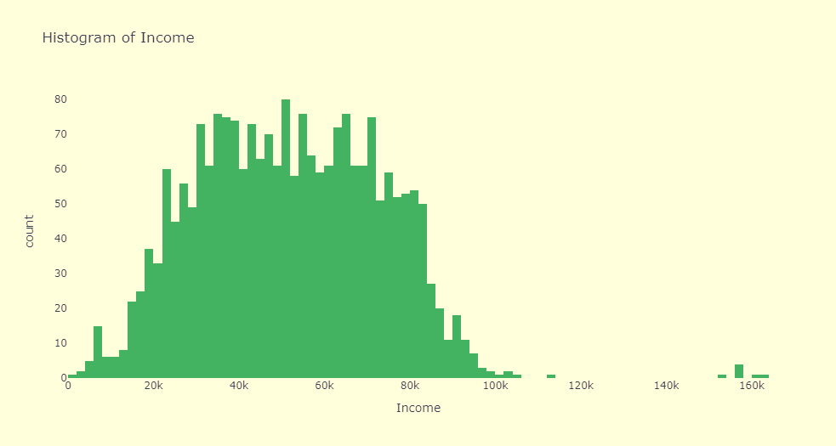
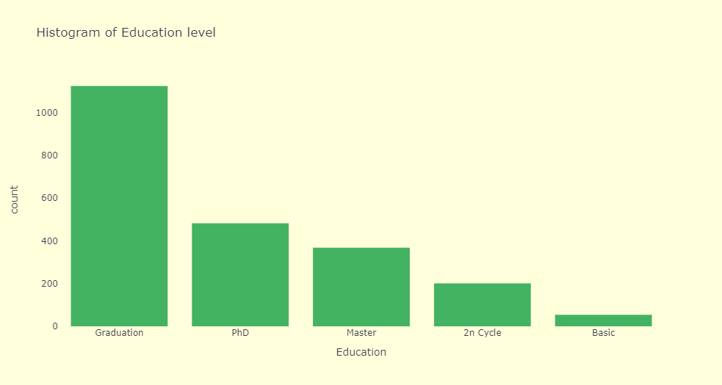
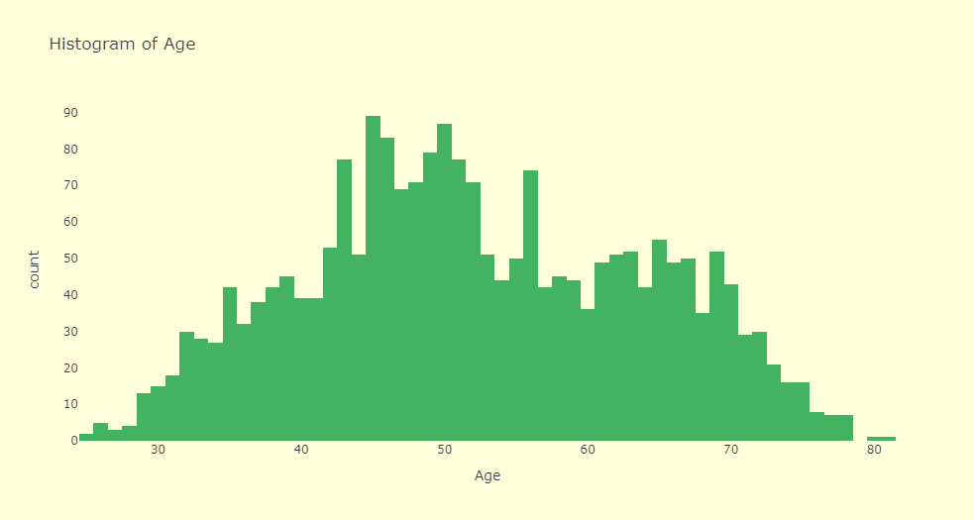
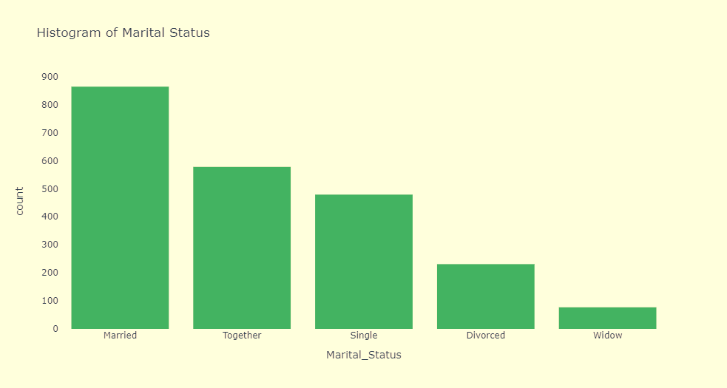
Customer Profile

Slide 6
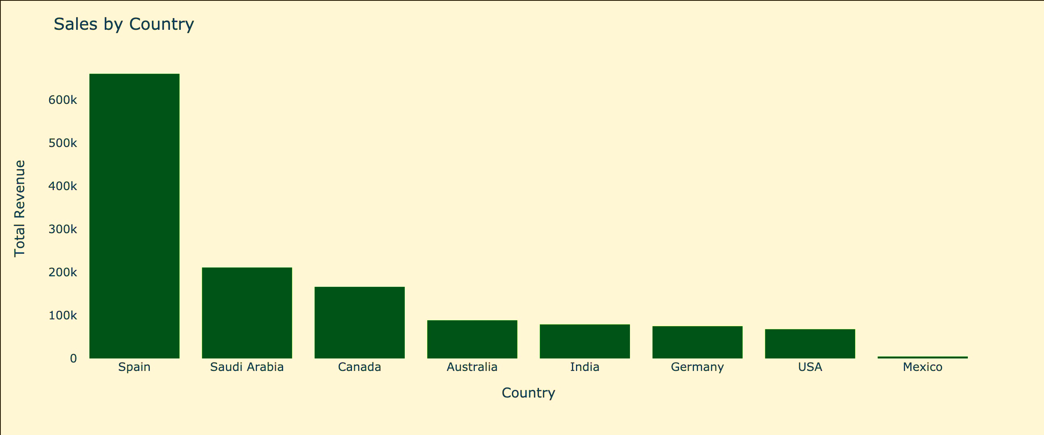
Sales by Country
Country | Customer Count | Total Sales
Spain | 1094 | $ 660,367
Saudi Arabia | 335 | $ 210,987
Canada | 263 | $ 166,169
Australia | 159 | $ 88,547
India | 146 | $ 78,996
Germany | 120 | $ 74,913
USA | 109 | $ 67,882
Mexico | 3 | $ 3,122

Slide 7
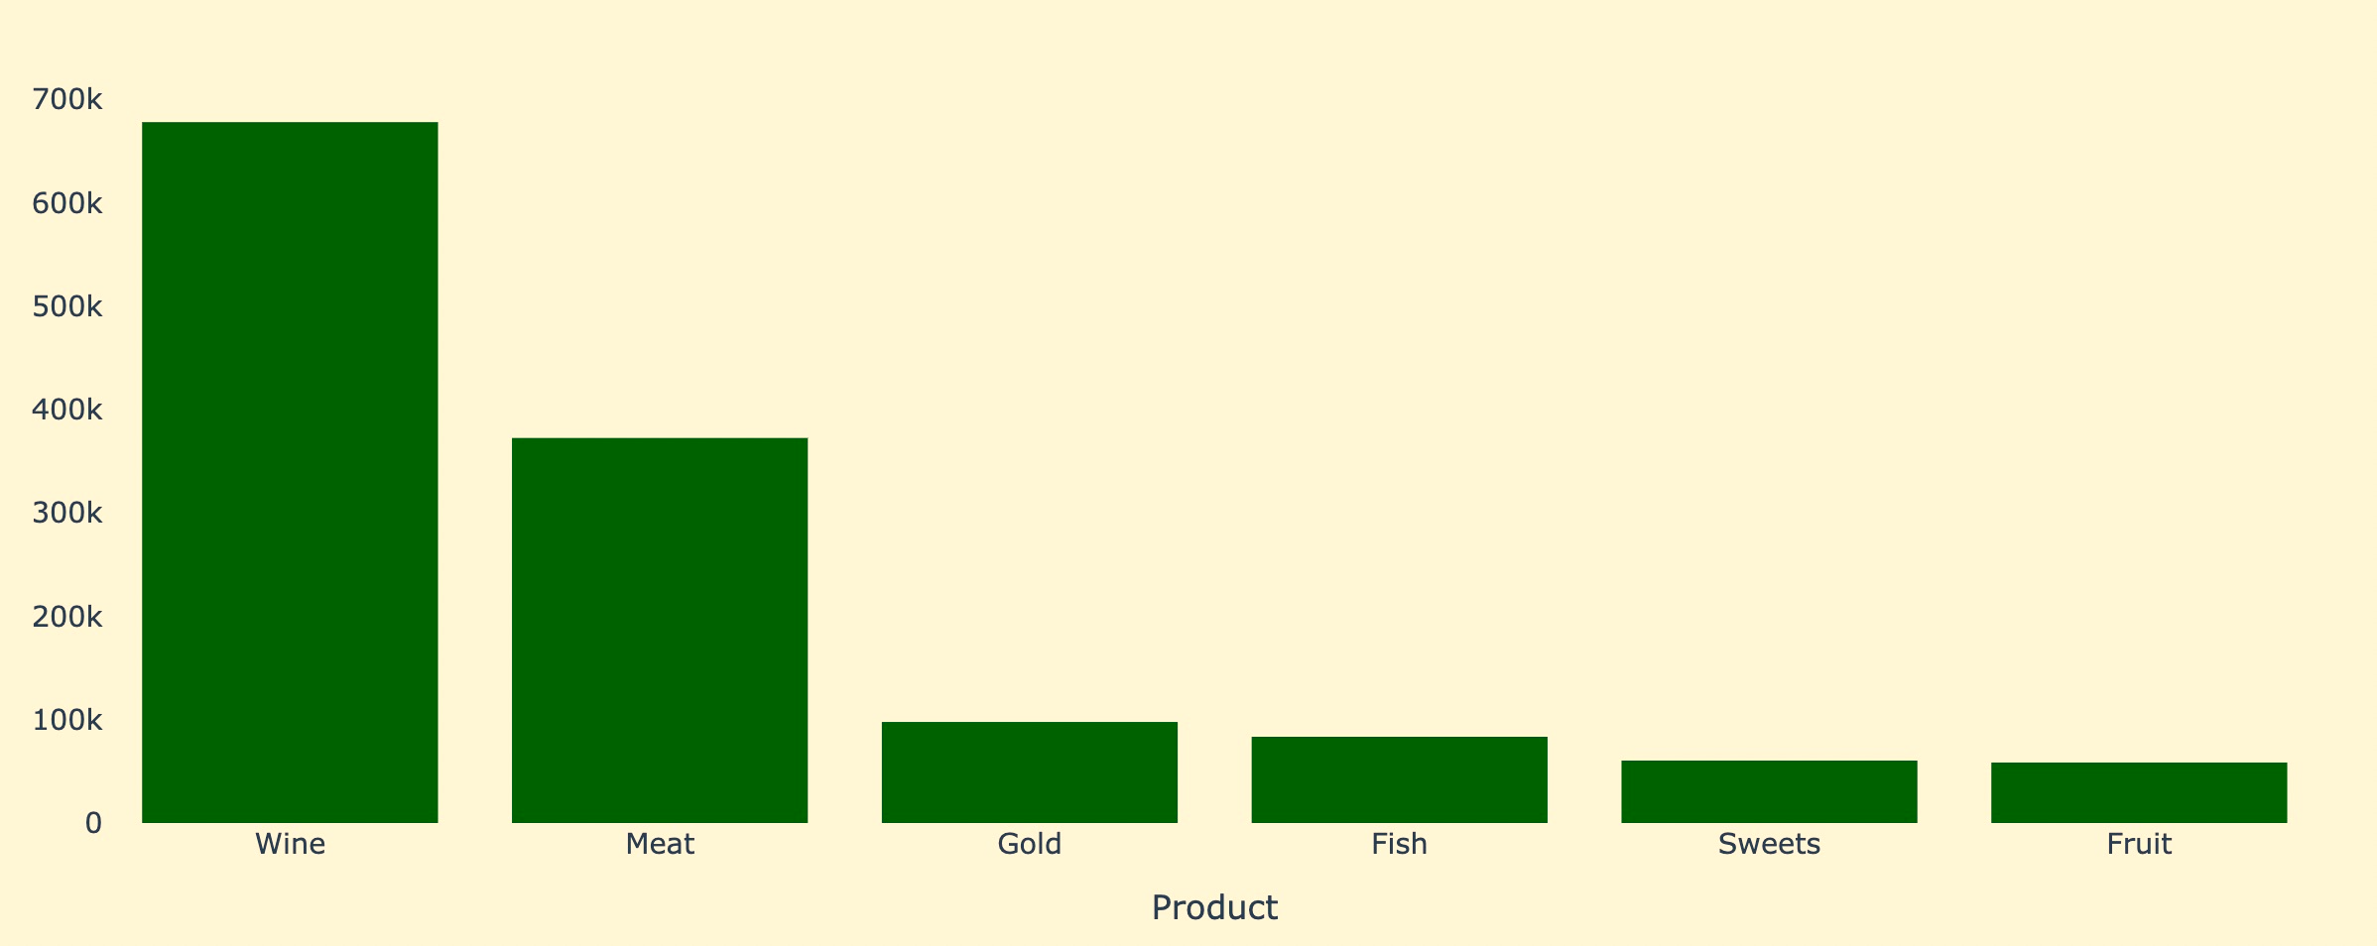
Sales by Product
678120
372571
97773
83489
60464
58566

Slide 8
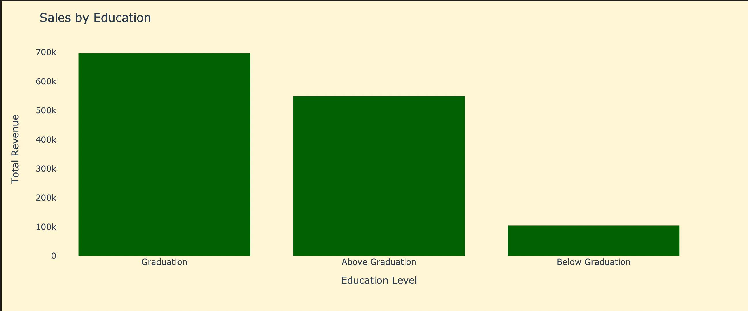
Demographic: Education
Sales by Education Level
Education Level | Customer Count | Total Sales
Graduation | 1124 | $ 697,259
PhD | 482 | $ 324,041
Masters | 368 | $ 224,558
2n Cycle | 201 | $ 100,708
Basic | 54 | $ 4,417

Slide 9
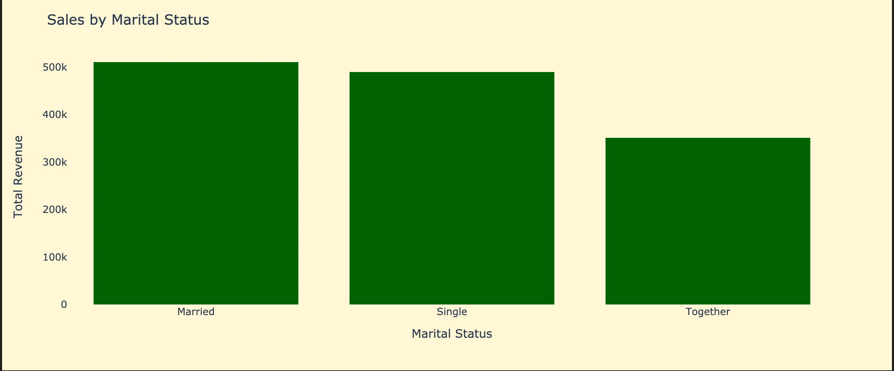
Demographic: Marital Status
Sales by Marital Status
Marital Status | Customer Count | Total Sales
Married | 864 | $ 510,453
Together | 578 | $ 350,950
Single | 479 | $ 291,090
Divorced | 231 | $ 141,601
Widow | 77 | $56,889

Slide 10

Demographic: No of Dependents
Sales by number of dependents
# of Dependents | Customer Count | Total Sales
Zero | 635 | $ 701,409
One | 1122 | $ 532,157
Two | 419 | $ 102,863
Three | 53 | $ 14,554

Slide 11
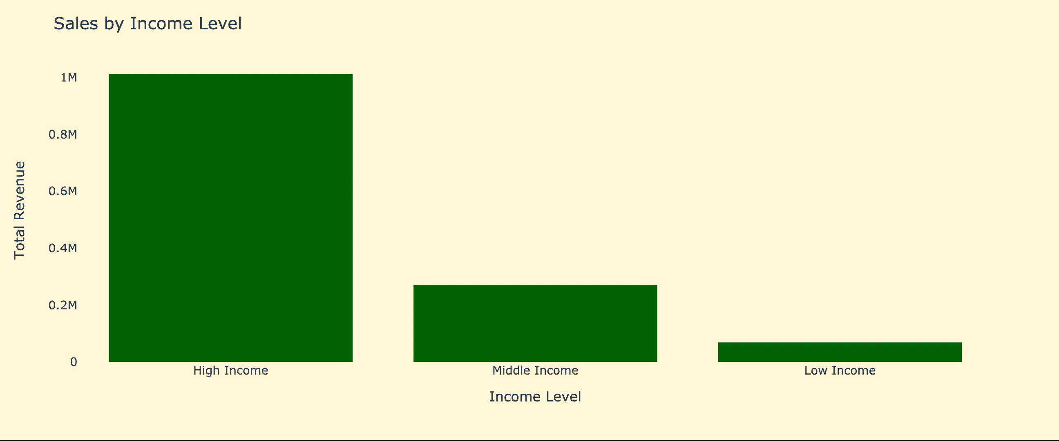
Demographic: Income
Sales by Income Level
Age Levels | Customer Count | Total Sales
High Income | 836 | $ 1,014,181
Middle Income | 664 | $ 268,307
Low Income | 729 | $ 68,495

Slide 12
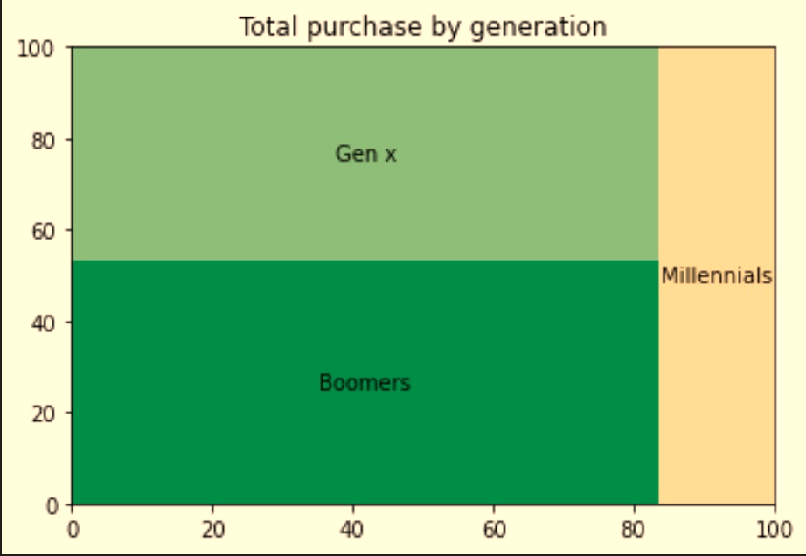
Demographic: Age
Sales by Age Segment
Age Levels | Customer Count | Total Sales
Boomers | 781 | $ 554,451
Gen X | 1026 | $ 551,185
Millenials | 422 | $ 241,347

Slide 13
PROJECT OVERVIEW
COUNTRIES
8 Countries
USA
SPAIN
SAUDI ARABIA
MEXICO
CANADA
AUSTRALIA
INDIA
GERMANY
PRODUCTS
6 Products
WINE
MEAT
FRUITS
FISH
SWEETS
GOLD
DEMOGRAPHIC FACTORS
5 Demographic factors
INCOME LEVEL
AGE SEGMENT
EDUCATION LEVEL
MARITAL STATUS
# DEPENDENTS

Slide 14
DASHBOARD
z

Slide 15
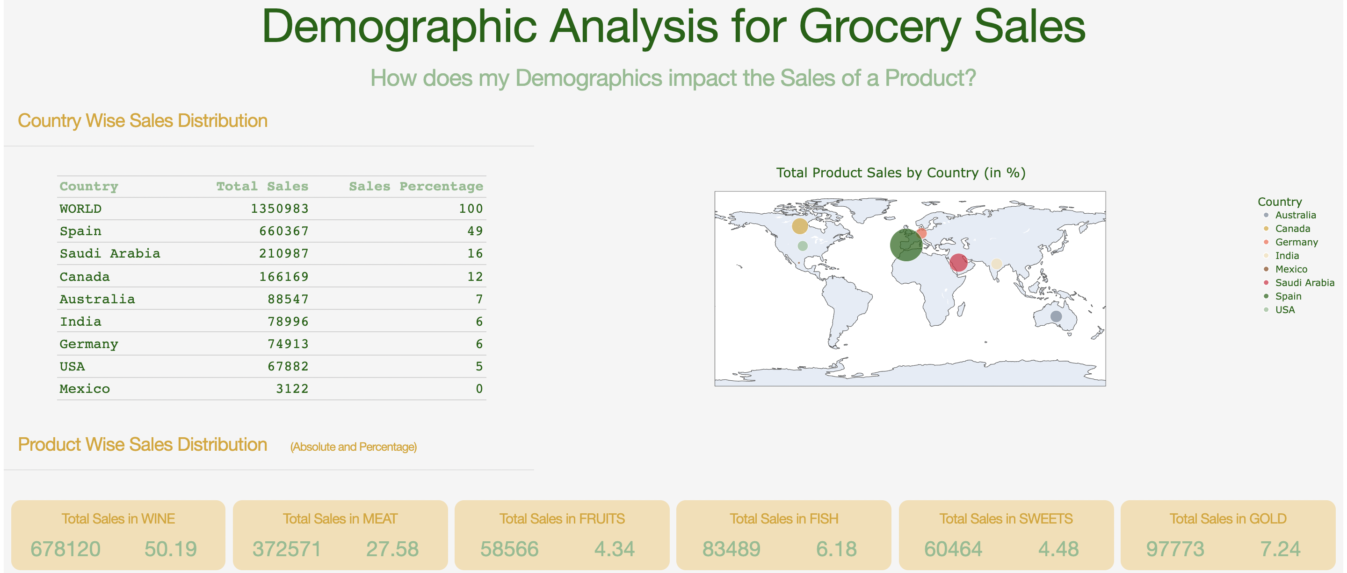
OVERVIEW: WORLD SALES (1/2)

Slide 16
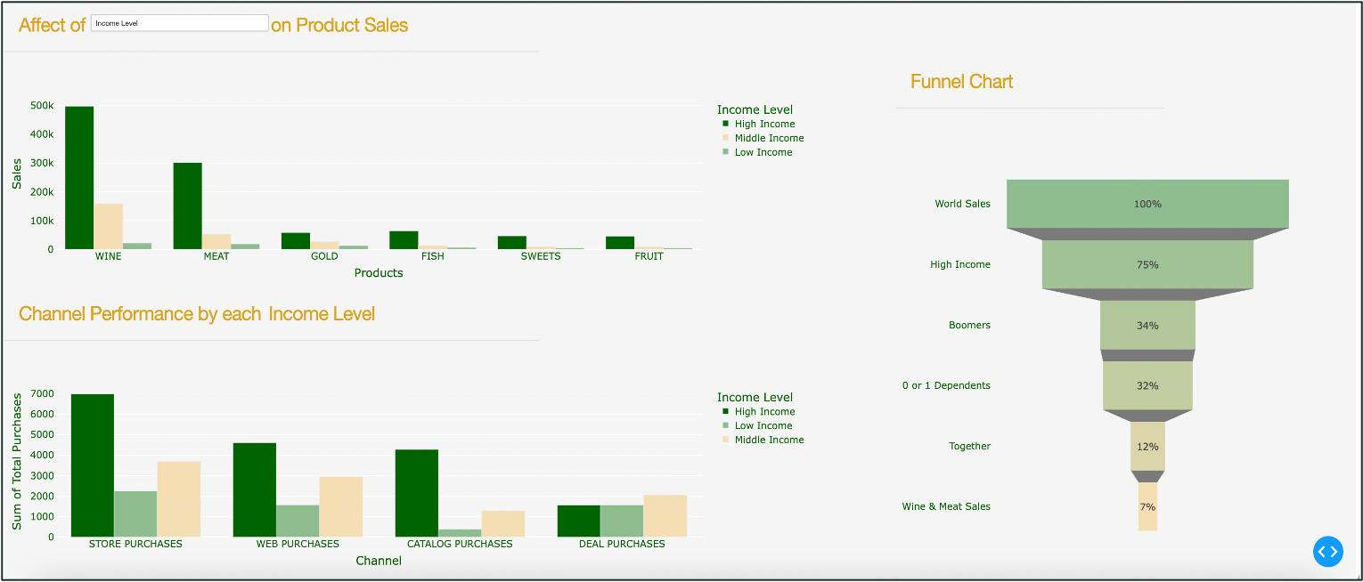
OVERVIEW: WORLD SALES (2/2)

Slide 17
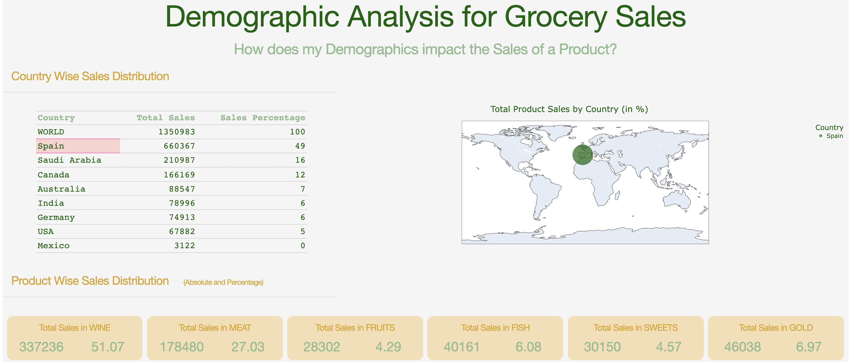
COUNTRY: SPAIN SALES (1/2)

Slide 18
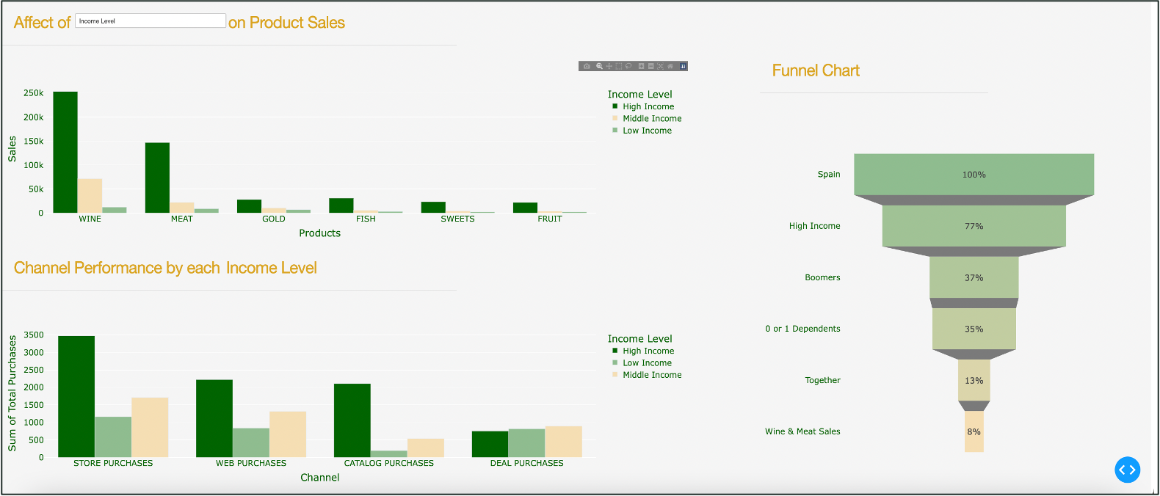
COUNTRY: SPAIN SALES (2/2)

Slide 19
APPENDIX
z

Slide 20
Data Source
Data Source:
Maven Analytics: https://www.mavenanalytics.io/data-playground?search=marketing
Records in the Database: 2240

Slide 21

Missing Data Analysis
Remove records with potential outliers or wrong values
Removed Records with:
Marital Status: YOLO, Absurd, Alone (7 rows)
Age: Above 100 Years (3 rows)
Income: $666666 (1 row)
Listwise Deletion
Insert values with Median values of same category
Median Income for missing values substituted based on:
Median Income level by Country
Median Substitution

Slide 22
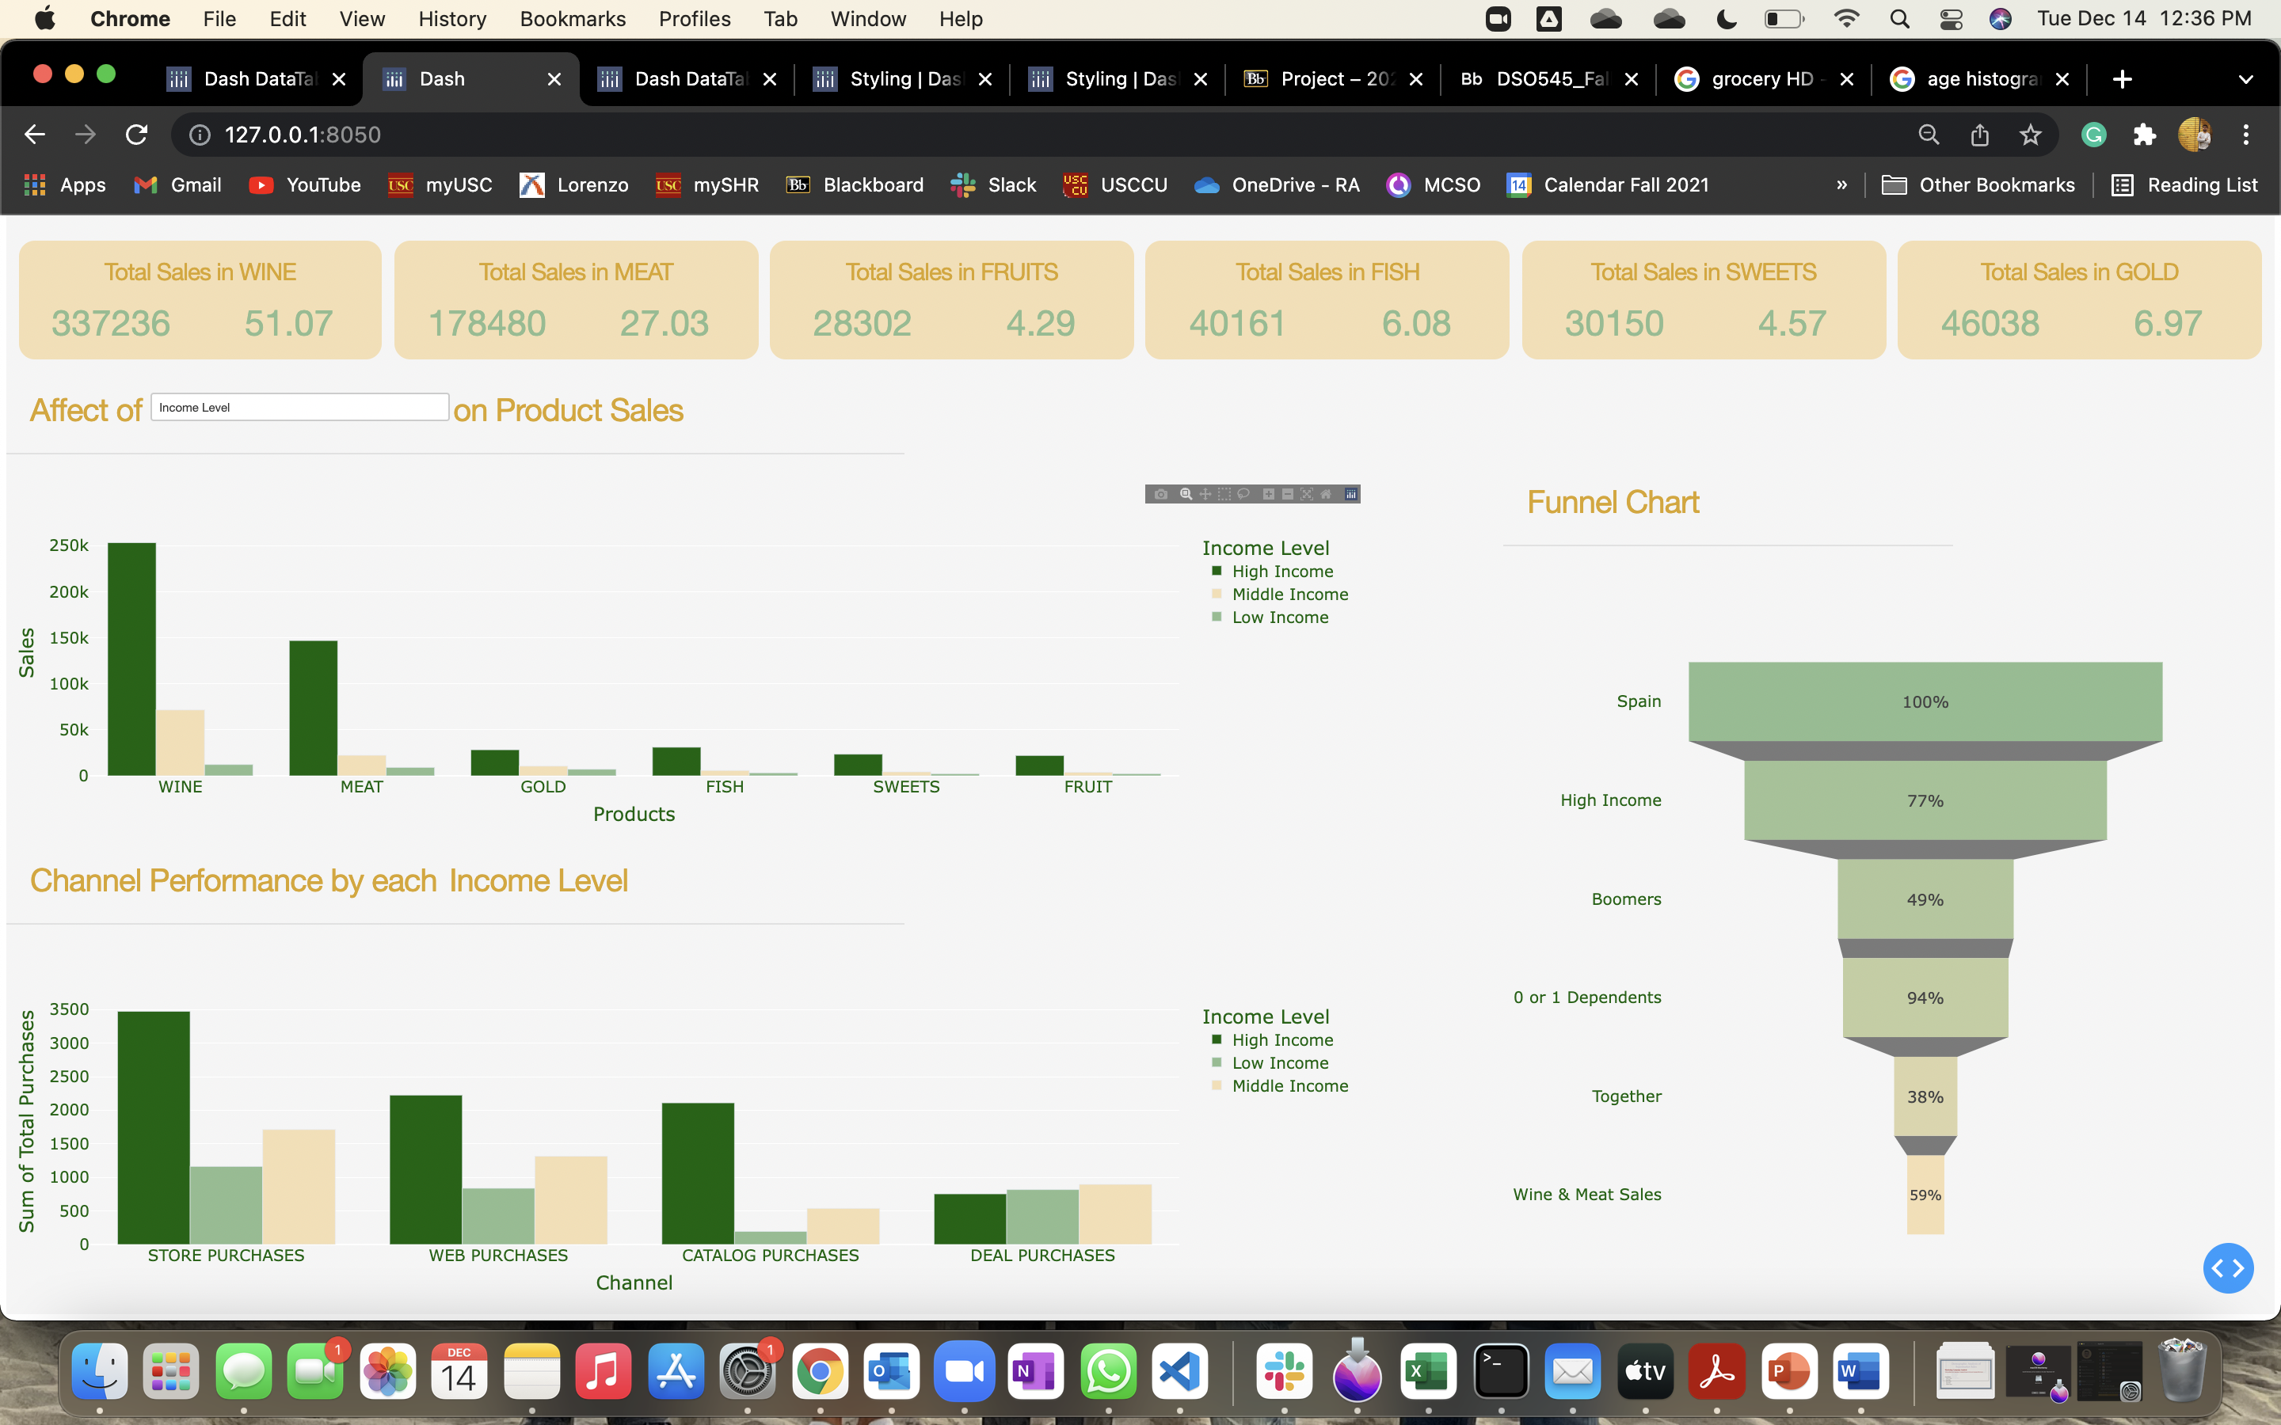
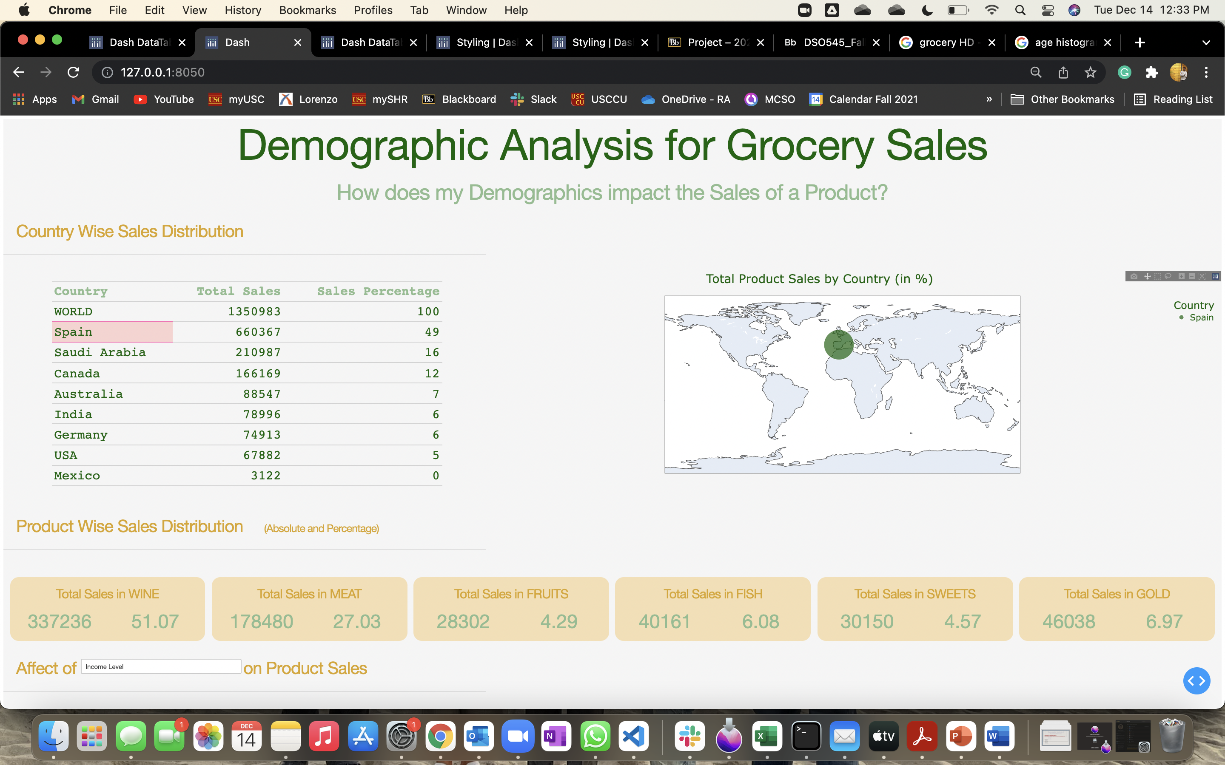
Navigating through Dashboard
1. Set webpage zoom level = 50% (mac)
2. Select country by clicking on the table row
3. Choose relevant demographic from the demographic dropdown

Slide 23
Thank you
z

